Slide 1
MIS 3301 Intro. to Business Programming Logic
Ch 4 – Repetition Structures
Mrs. Nancy G. Sánchez

Slide 2
Outline
Types of Loops
WHILE Loop
FOR Loop
Augmented Assignment Operators
Counter Variables
Running Total
Input Validation Loops
Loop Control Statements
Nested Loops

Slide 3
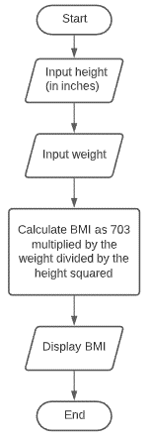
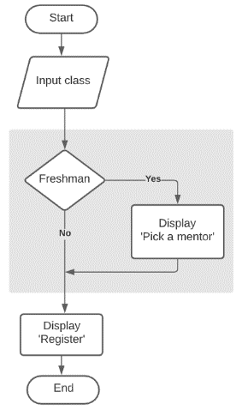
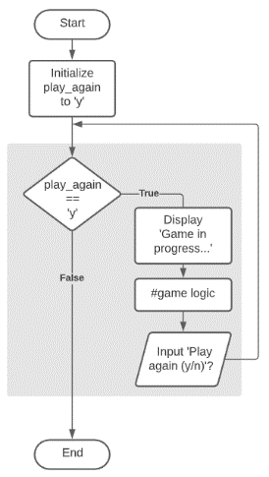
Control Structures
Control Structures – logical design that controls the order in which statements execute
Sequence
Decision
Repetition

Slide 4
WHILE loop

Slide 5
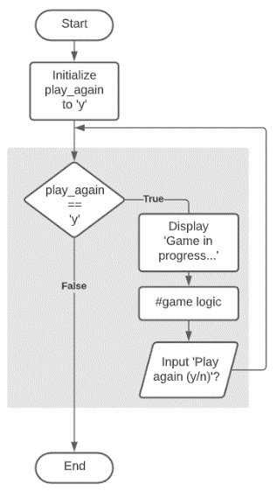
WHILE loop
The WHILE loop is a condition-controlled loop
It uses a true/false condition to control the number of iterations
It is also known as a pre-test loop because it must pass the condition before entering the loop.

Slide 6
WHILE loop
An iteration variable is the variable used to control the loop – you must initialize it, test it, and update it!
Give it an appropirtae name:
another_order, another_customer, another_entry, play_again, etc.
Initialize the
Iteration Variable
loop_again = 'y'
while loop_again == 'y':
…
…
loop_again = input('Do you want to loop again (y/n)? ')
test the Iteration Variable
while clause
colon
block
Update the
Iteration Variable

Slide 7

WHILE loop – Example: Indefinite Loop
The number of iterations is not known (before execution).
play_again = 'y'
while play_again == 'y':
print('\nGame in progress…')
#Game logic goes here
play_again = input(' Do you want to play again (y/n)? ')
Initialize
test
Update
Output Window
Game in progress…
Want to play again (y/n)? y
Game in progress…
Want to play again (y/n)? n

Slide 8
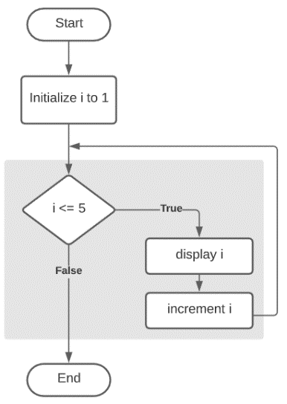
WHILE loop – Example: Definite Loop
The number of iterations is known (before execution).
i = 1
while i <= 5:
print('i is:', i)
i = i + 1
Initialize
test
Update
Output Window
i is: 1
i is: 2
i is: 3
i is: 4
i is: 5
Even though WHILE loops can handle definite loops,
a FOR loop is more appropriate for this.

Slide 9
Sentinel Value
A sentinel value is a value that marks the end of a loop; it must be different than a valid value.
prod_num = int(input('\nEnter a product number (or 9999 to exit): '))
while prod_num != 9999:
#add code to lookup & display product data here
prod_num = int(input('\nEnter a product number (or 9999 to exit): '))
print('\nProgram ended')
Output Window
Enter a product number (or 9999 to exit): 783
Enter a product number (or 9999 to exit): 417
Enter a product number (or 9999 to exit): 9999
Program ended

Slide 10
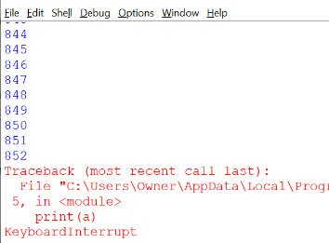
Infinite Loop
Occurs when one does not update the iteration variable
Can exit the Shell window or press Ctrl+C to break out of the loop
cont = 'y'
a = 1
while cont == 'y':
print(a)
a = a + 1
What is missing?
___________________

Slide 11
Watch out for uppercase and lowercase!
As we learned in the Chapter 2 – IFs, someimtes we need to convert the user input to upper or lowercase.
cont = 'y'
a = 1
while cont == 'y':
print(a)
a = a + 1
cont = input('Do you want to continue (y/n)? ')
print('\n>> End of processing')
Output Window
1
Do you want to continue (y/n)? Y
>> End of processing
Solutions:
while cont == 'y' or cont == 'Y':
OK
while cont.lower() == 'y':
PREFERRED

Slide 12
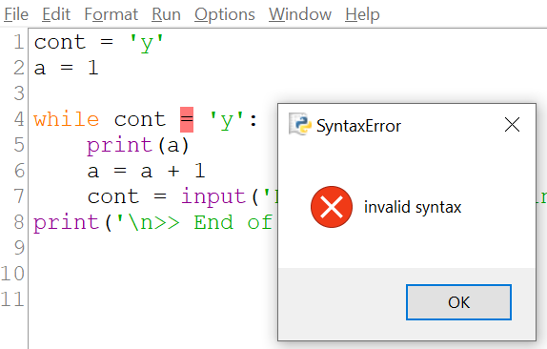
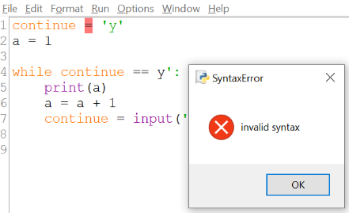
Debugging
Watch out for this…
Don’t use Python reserved words!
Pay attention
to color coding!
Solution:
___________________
Solution:
___________________

Slide 13
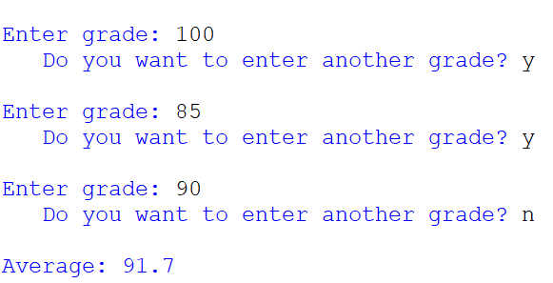
Exercise 1 – WHILE loop
Write a program that allows a user to enter as many grades as they would like - this type of WHILE loop is this a(n): ___________ loop? Then calculate & display the average. Assume all scores have an equal weight.
Copy the following comment lines.
Write the code using a WHILE loop.
Save your program as: Ch4-Ex01-WHILE-Loop.py
Run it!
#-- Ch4-Ex01-WHILE-Loop.py
#Initialize variables
#Loop to collect & total scores
#Calc average
#Display Output

Slide 14
FOR Loop

Slide 15
FOR loop
The FOR loop is a count-controlled loop.
It iterates through a specific number of items
Use a FOR loop, when you have a definitive number of items to loop through
We will use a FOR loop to iterate through the following 2 types of iterables:
Lists – lists are iterables → e.g. [10, 99, 3, 21] or ['John', 'Jen', 'Bob’]
range() – produces an iterable → e.g. range(1, 10, 2)
An iterable is an object that can contain multiple elements and can return its members one at a time.
Note: strings are iterables as well

Slide 16
FOR loop – using a List
Syntax for a LIST:
[item1, item2, item3, …]
Target
variable
List
for num in [1234, 56, 989, 1]:
print(num)
Output window
1234 | 56 | 989 | 1
1234
56
989
1
It’s better to view this LIST object horizontally now,
as later we will be working with
2-Dimensional Lists that look tabular (i.e. with rows & columns)
A list can also be defined before the loop;
use a plural variable name for clarity
products = ['Bike', 'Chair', 'Desk']:
for product in products:
print(product)
‘Bike’ | ‘Chair’ | ‘Desk’
Output window
Bike
Chair
Desk

Slide 17
FOR loop – using a Range() function
Target
variable
Range
Syntax for a RANGE
0
1
2
3
4
range(start, stop, step)
for num in range(5):
print(num)
Exclusive
5
6
7
8
9
for num in range(5, 10):
print(num)
The range() function returns an iterable
- i.e. an object similar to a list
for num in range(10, 50, 10):
print(num)
10
20
30
40
for num in range(10, 0, -2):
print(num)
10
8
6
4
2

Slide 18
The user can also control a FOR loop
Option 1:
end_value = int(input('Enter an ending value: '))
for num in range(10, end_value + 1, 10):
print(num)
Enter an ending value: 100
10
20
30
40
50
60
70
80
90
100
Option 2:
end_value = int(input('Enter an ending value: '))
stop_value = end_value + 1
for num in range(10, stop_value, 10):
print(num)
Option 3:
end_value = int(input('Enter an ending value: ')) + 1
for num in range(10, end_value, 10):
print(num)
….but be careful to NOT alter user input as we may need to know what the user entered later.

Slide 19

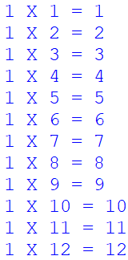
Exercise 2 – FOR loop
Save your program as: Ch4-Ex02-FOR-Loop.py
Version 1:
Write a FOR Loop to generate the following range of numbers:
Version 2:
Add the following comment lines to your code
Edit your code to generate the following:
#-- Ch4-Ex02-FOR-Loop.py
#Version 1 – FOR Loop to display 1 to 12
#Initialize variables
practice_num = 1
#Version 2 – Loop to calc & display answer

Slide 20
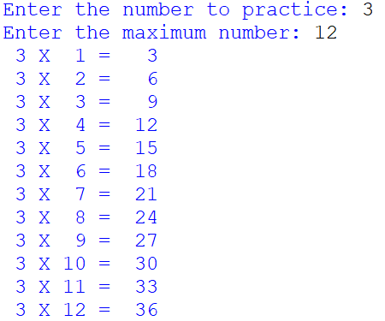
Exercise 3 – FOR loop
Save the previous file from Exercise 2 as Ch4-Ex03-FOR-Loop-DYNAMIC.py
Alter the code to make it more dynamic:
Allow the user to pick a practice number instead of it always being 1.
Allow the user to pick the maximum number instead of it always being 12.

Slide 21
WHILE loop - How many iterations?
Iteration – one execution of the loop block
i = 0
while i < 4:
print('i is:', i)
i = i + 1
i = 1
while i <= 3:
print('i is:', i)
i = i + 1
i = 3
while i <= 20:
print('i is:', i)
i = i + 2
i = 10
while i >= 2:
print('i is:', i)
i = i - 1
#iterations:
#iterations:
#iterations:
#iterations:
4
3
??
9

Slide 22
FOR loop - How many iterations?
Iteration – one execution of the loop block
for num in range(0, 3):
print(num)
for num in range(2, 8):
print(num)
for num in range(3, 8):
print(num)
for num in range(10, 3, -1):
print(num)
#iterations:
#iterations:
#iterations:
#iterations:
??
??
??
??

Slide 23
Augmented Assignment Operators
Calculate & assign operators

Slide 24
Augmented Assignment Operators
Augmented Assignment Operators are shortcut operators.
Also known as: Calculate & Assign Operators, Compound Operators
Long way
Preferred
i = i + 1
i += 1
increments i by 1
variable
Add
& Assign
value
i += 4 / num * 3
Assume: i = 2 and num = 2
What is the value of i ?
8.0
9.0
Entire right-hand side is evaluated first.

Slide 25
Augmented Assignment Operators
Long way
Preferred
Calculate and Assign
a = a + 2
a += 2
Add and assign
a = a - 2
a -= 2
Subtract and assign
a = a * 2
a *= 2
Multiply and assign
a = a / 2
a /= 2
Divide and assign
a = a // 2
a //= 2
Divide and assign
a = a % 2
a %= 2
Remainder and assign
a = a ** 2
a **= 2
Exponentiation and assign

Slide 26
Augmented Assignment Operators
Add to total sales
Long way
total_sales = total_sales + current_sales
Augmented
Assignment Operator
total_sales += current_sales
Apply a 10% discount on an order
Long way
order_total = order_total * .90
Augmented
Assignment Operator
order_total *= .90

Slide 27
Counter Variables
Keep track of loop iterations

Slide 28
Counter Variables
Keeps track of how many times a loop has executed.
i = 1
while i <= 5:
print('i is:', i)
i += 1
play_again = 'y'
count = 0
while play_again == 'y':
print('\nGame in progress…')
#Game logic goes here
count += 1
play_again = input(' >> Want to play again (y/n)? ')
print('\nGame was played', count, 'times')
Recall that: i += 1
is the same as: i = i + 1

Slide 29
Running Total
Accumulating a Value

Slide 30
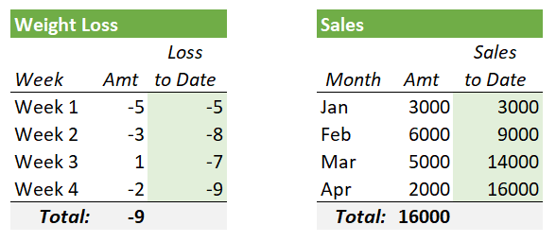
Running Total – the concept
1st: learn the concept called Running Total (i.e. accumulating a value).
Running Total
Running Total

Slide 31
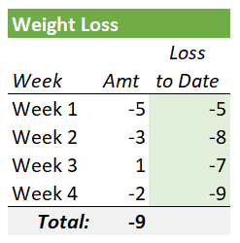
Running Total – programming logic
2nd: Learn the programming logic!
total_loss
0
initialize the accumulator
Loop
get the current value
add value to the accumulator
curr_loss
This pseudocode intentionally does not show how to loop, nor what variables to display (nor when) as all of this varies by application.

Slide 32
Running Total – Weight Example
You can accumulate a value in a WHILE loop.
Here we are calculating total weight loss from user-inputted values.
Initialize Accumulator
variable to 0
Enter weekly weight loss: -5
This week: -5.0 Total to date: -5.0
Do you want to enter another weight (y/n): y
Enter weekly weight loss: -3
This week : -3.0 Total to date: -8.0
Do you want to enter another weight (y/n): y
Enter weekly weight loss: 1
This week : 1.0 Total to date: -7.0
Do you want to enter another weight (y/n): y
Enter weekly weight loss: -2
This week : -2.0 Total to date: -9.0
Do you want to enter another weight (y/n): n
Total weight: -9.0
total_loss = 0
another_weight = 'y'
while another_weight.tolower() == 'y':
curr_loss = float(input('\nEnter weekly weight loss: '))
total_loss += curr_loss
print(' This week:', curr_loss, '\tTotal to date:', total_loss)
another_weight = input(' Do you want to enter another weight (y/n): ')
print('\nTotal weight:', format(total_loss, '4.1f'))
Get current
value
Add the new amount

Slide 33
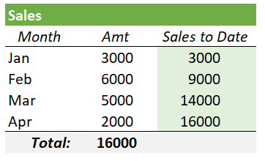
Running Total – Sales Example
You can also accumulate a value when using a FOR loop.
Here we are calculating total sales from this range of hardcoded values.
Curr Sales: 3000 Total to Date: 3000
Curr Sales: 6000 Total to Date: 9000
Curr Sales: 5000 Total to Date: 14000
Curr Sales: 2000 Total to Date: 16000
Total Sales: 16,000
Initialize
Accumulator
variable to 0
total_sales = 0
for current_sales in [3000, 6000, 5000, 2000]:
total_sales += current_sales
print('Curr Sales:', current_sales, '\tTotal to Date:', total_sales)
print('\nTotal Sales:', format(total_sales, '4,d'))
Get current
value
Add the new
amount

Slide 34
Running Total – Sales Example
Before:
FYI: Always make the output easier to read!
Curr Sales: 3000 Total to Date: 3000
Curr Sales: 6000 Total to Date: 9000
Curr Sales: 5000 Total to Date: 14000
Curr Sales: 2000 Total to Date: 16000
Total Sales: 16,000
print('Total Sales Report\n')
print('Current Total')
print('-'*16)
total_sales = 0
for current_sales in [3000, 6000, 5000, 2000]:
total_sales += current_sales
print(format(current_sales, '6,d'), ' ', format(total_sales, '6,d'))
print('\nTotal Sales:', format(total_sales, '6,d'))
After:
Total Sales Report
Current Total
----------------
3,000 3,000
6,000 9,000
5,000 14,000
2,000 16,000
Total Sales: 16,000

Slide 35
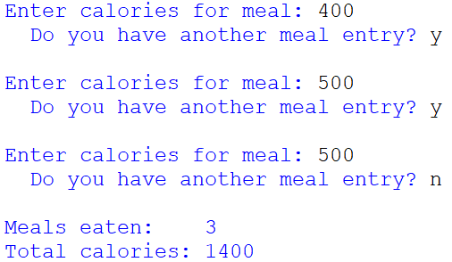
Exercise 4 – Running Total
Write a program that allows a user to enter calories for each meal they have eaten.
Copy the following comment lines.
Write the code using a WHILE loop.
Use a counter named i to keep track of the number of meals eaten
Use a running total named total_calories to keep track of the total calories
Save your program as: Ch4-Ex04-Running-Total.py
Run it!
#-- Ch4-Ex04-Running-Total.py
#Initialize variables
#Loop to get user input & calc running total
#Display output

Slide 36
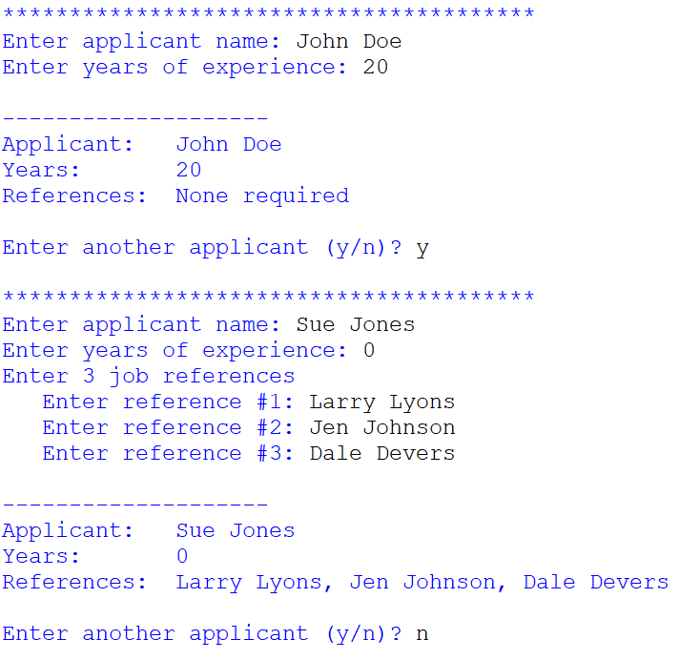
Can add other statements inside a loop
Practice this without looking at the solution. An employer is entering an applicant’s name and years of experience. If they have no years of experience, then 3 references are required. Use a WHILE loop to prompt for the name & years, and a FOR loop to prompt for the 3 required references.
cont = 'Y'
while cont.upper() == 'Y':
print('\n','*'*40, sep='')
name = input('Enter applicant name: ')
years_exp = int(input('Enter years of experience: '))
if years_exp == 0:
all_refs = ''
print('Enter 3 job references')
for i in range(0,3):
ref = input(' Enter reference #' + str(i+1) + ': ')
if i == 0:
all_refs = ref
else:
all_refs += ', ' + ref
else:
all_refs = 'None required'
print('\n','-'*20)
print('Applicant: ', name)
print('Years: ', years_exp)
print('References: ', all_refs)
cont = input('\nEnter another applicant (y/n)? ')
Solution

Slide 37
Input Validation
Validating user input

Slide 38
Input Validation
Assume that to register for a technology camp, the person must be between the ages of 13 and 16.
1.
2.
3.
4.
5.
6.
age = int(input('Enter age: '))
#Input validation
while age < 13 or age > 16:
print(' Age must be 13 to 16 years old. Please enter a valid age.\n')
age = int(input('Enter age: '))
print('\nAge is valid!')
Prompt for the value
Test the error case
Display a specific
error message
Prompt for the value again
Output Window
….but notice this issue
Enter age: 11
Age must be 13 to 16 years old. Please enter a valid age.
Enter age: 25
Age must be 13 to 16 years old. Please enter a valid age.
Enter age: 13
Age is valid!
Enter age: A
…line 5, in <module>
age = int(input('Enter age: '))
ValueError: invalid literal for int() with base 10: 'A'

Slide 39


We will need a Numeric Value Test
isdigit() tests any string to see if it contains only numeric digits: 0-9
a string
method
any_str.isdigit()

Slide 40
Testing a String for a Numeric Value
This validation handles all invalid data: letters and numbers
str_age = input('Enter age: ')
#Input validation
while not str_age.isdigit() or (int(str_age) < 13 or int(str_age) > 16):
print(' Age must be 13 to 16 years old. Please enter a valid age.\n')
str_age = input('Enter age: ')
#Convert input to numeric
age = int(str_age)
print('\nAge is valid!', age)
Do not convert the string yet!
Add the test for isdigit()
Do not convert the string yet!
After the validation is passed, convert it!

Slide 41
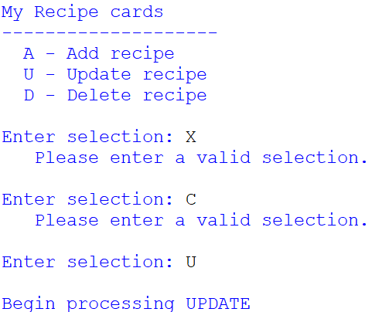
Exercise 5 – Input Validation
Write a program that allows validates a user’s menu selection.
Copy the following code.
Prompt the user for a menu selection.
Write a WHILE loop to validate the selection.
Write an IF statement to display the appropriate processing message .
Save your program as: Ch4-Ex05-Input-Validation.py
Run it!
#-- Ch4-Ex05-Input-Validation.py
#Display Menu
print('\nMy Recipe cards')
print('-'*20)
print(' A - Add recipe')
print(' U - Update recipe')
print(' D - Delete recipe')
#Get user input
#Input validation
#Process selection

Slide 42
Loop Control Statements

Slide 43
Loop Control Statements
Loop control statements allow you to change the execution of a loop from its normal sequence.
break
continue
pass

Slide 44
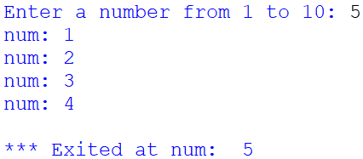
break
break - exits (breaks) out of the loop immediately!
Add this to a loop when you need the loop to stop processing.
It will then continue with the next line of code after the loop block
user_num = int(input('Enter a number from 1 to 10: '))
for num in range(1,11):
if num == user_num:
break
print('num:', num)
print('\n*** Exited at num: ', num)
Use breaks this sparingly!

Slide 45
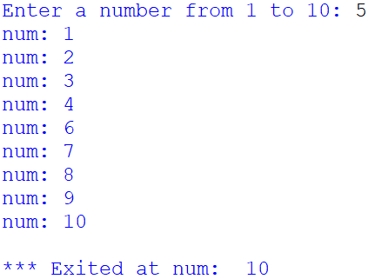
continue
continue - skips (continues) to the next iteration
Add this to a loop when you want it to stop processing the current iteration and move on to the next iteration.
For example, if the iteration variable is currently set to 4, it will go back to the top of the loop and start processing value 5.
user_num = int(input('Enter a number from 1 to 10: '))
for num in range(1,11):
if num == user_num:
continue
print('num:', num)
print('\n*** Exited at num: ', num)

Slide 46

pass
pass – does nothing
Used as a placeholder for future code; stub testing
May include this in Loops and IF statements!
user_num = int(input('Enter an integer < 10: '))
for num in range(1,11):
pass
print('\n*** Exited at num: ', num)
user_num = int(input('Enter an integer < 10: '))
if user_num <= 5:
print('Low value')
else:
pass

Slide 47
Altering the Loop’s Logic: 2 Approaches
Break statement
While loop with Boolean Variable
user_num = int(input('Enter a number from 1 to 10: '))
for num in range(1,11):
if num == user_num:
break
print('num:', num)
print('\n*** Exited at num: ', num)
user_num = int(input('Enter a number from 1 to 10: '))
num_found = False
num = 1
while num <= 10 and not num_found:
if num == user_num:
num_found = True
else:
print('num:', num)
num += 1
print('\n*** Exited at num: ', num)
Use breaks this sparingly!

Slide 48
Nested Loops
Note: we will code Nested Loops again in Ch 7 when we work with 2-dimensional lists

Slide 49
Nested FOR Loop
1st: understand the Processing Logic
Outer loop
for course in ['MIS3301', 'MIS3320', 'MIS4321']:
for section in ['01', '02']:
Inner loop
Processing order:
Processes Course MIS3301
Then Section 01
Then Section 02
Processes Course MIS3320
Then Section 01
Then Section 02
Processes Course MIS4321
Then Section 01
Then Section 02

Slide 50
Nested FOR Loop
2nd: know where to add code
for course in ['MIS3301', 'MIS3320', 'MIS4321']:
A
for section in ['01', '02']:
B
C

Slide 51
Nested FOR Loops - Course & Section
Output Window
for course in ['MIS3301', 'MIS3320', 'MIS4321']:
print(course)
for section in ['01', '02']:
print(' ', section)
MIS3301
01
02
MIS3320
01
02
MIS4321
01
02
Output Window
for course in ['MIS3301', 'MIS3320', 'MIS4321']:
for section in ['01', '02']:
print(course, '-', section)
MIS3301 - 01
MIS3301 - 02
MIS3320 - 01
MIS3320 - 02
MIS4321 - 01
MIS4321 - 02

Slide 52
Exercise 6 – Nested FOR Loop
Write a program that generates the output shown.
Copy the following code.
Add code to the 2 nested FOR loops to generate the output shown.
Save your program as: Ch4-Ex06-Nested-FOR-Loop.py
Run it!
Version 1 Output
Version 2 Output
#-- Ch4-Ex06-Nested-FOR-Loop.py
#Version 1 ----------------------------------------
for course in ['MIS3301', 'MIS3320', 'MIS4321']:
for section in ['01', '02']:
#Version 2 ----------------------------------------
#for course in ['MIS3301', 'MIS3320', 'MIS4321']:
#for section in ['01', '02']:
MIS3301
Sec: 01
Sec: 02
--- end of MIS3301
MIS3320
Sec: 01
Sec: 02
--- end of MIS3320
MIS4321
Sec: 01
Sec: 02
--- end of MIS4321
MIS3301 -01 -02
MIS3320 -01 -02
MIS4321 -01 -02

Slide 53
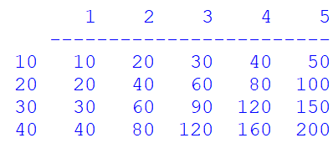
Exercise 7 – Nested FOR Loop
Write a program that generates the output shown.
Copy the following code.
Add code to the 2 nested FOR loops to generate the output shown.
Save your program as: Ch4-Ex07-Nested-FOR-Loop(2D-Tabular).py
Run it!
Tabular Output (2-Dimensional)
#-- Ch4-Ex07-Nested-FOR-Loop(2D-Tabular).py
for row in [10, 20, 30, 40]:
for col in [1, 2, 3, 4, 5]:

